Slide 1
www.informamarkets.com
UFI HR AWARD 2024
HOW EXHIBITION COMPANIES ARE FOSTERING A CULTURE OF LEARNING AND INNOVATION TO DRIVE BUSINESS TRANSFORMATION
Let’s start
Presented by:
Joyce Ho, HR Director - C&B and Operations (Asia)
Notes:
This is a picture of our colleagues our Bali Incentive Trip last year. At Informa, having “fun” in our Job is very important. Thus we always keep this in our mind with our HR initiatives. Leading to what I am going to share today. How we make learning fun!

Slide 2
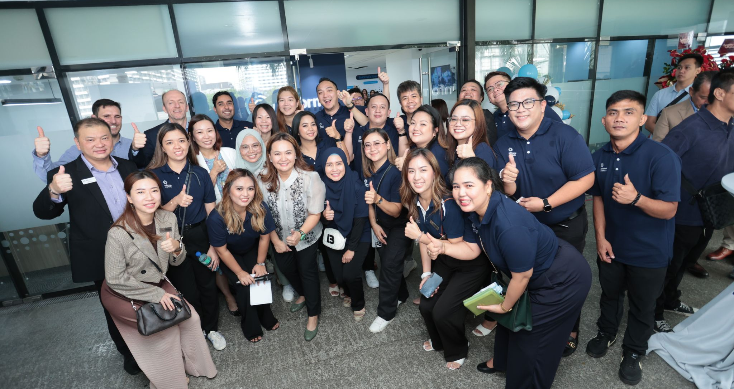
WHO WE ARE
Our Mission:
Informa Markets Asia aims to offer visitors, exhibitors, and partners insights into their future and unlock transformative business opportunities. The mission is to foster a culture of learning and innovation that drives business transformation and keeps things exciting.
Industry Leadership: As a leading B2B organization, Informa Markets Asia excels in organizing world-class exhibitions, conferences, and events across various global industries, staying at the forefront of industry trends and innovations.
Commitment to Learning and Innovation: The company emphasizes continuous learning and innovation, investing in the professional development of its team members. This enhances internal capabilities and enriches client and partner experiences.
Notes:
As a world class exhibition organiser, we need to Top talents. Thus we are committed to provide a continuous learning environment to our colleagues and equip them to becoming World Class Event Professionals

Slide 3
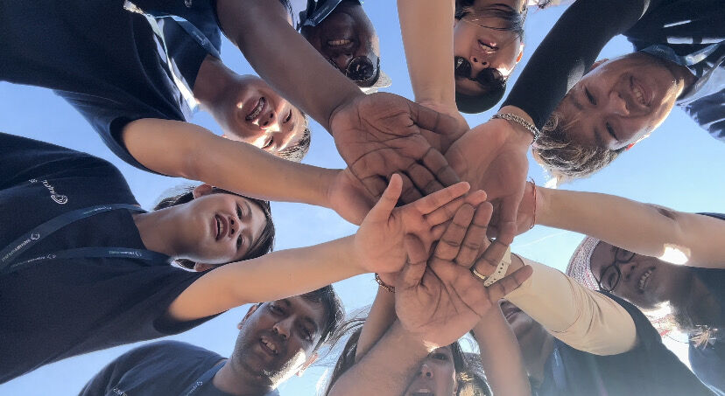
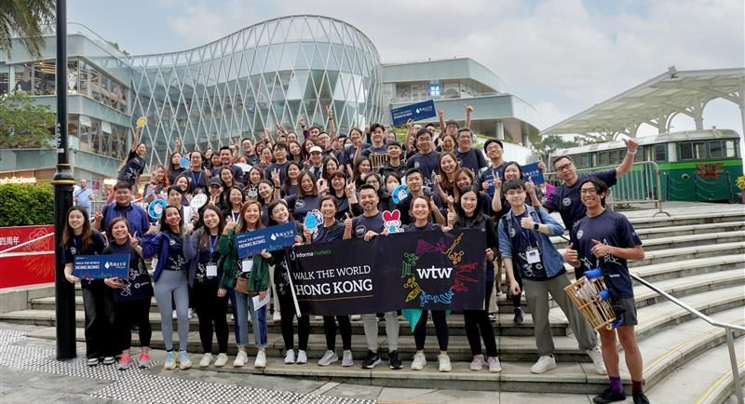
THE CHALLENGES WE FACE
Shifting Work Paradigms: The work environment has drastically changed, with increased emphasis on work-life balance, job satisfaction, and flexible, smart working environments. Employees seek roles that offer purpose and fulfillment beyond just a paycheck.
Evolving Employee Expectations: Modern employees prefer flexible work schedules that fit around their lives, valuing equality, freedom, and flexibility in their work.
Our Response: To adapt, we must be innovative, creative, and insightful towards our team members by embracing new working methods, offering flexible schedules, and fostering a supportive environment where employees feel valued and empowered.

Slide 4
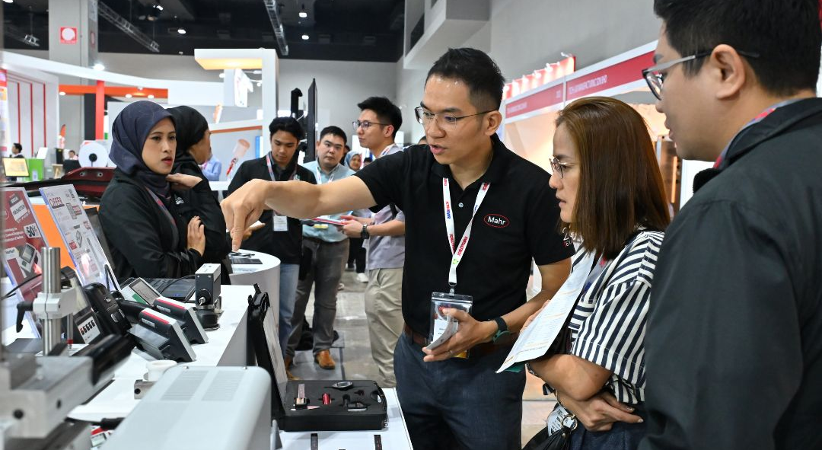
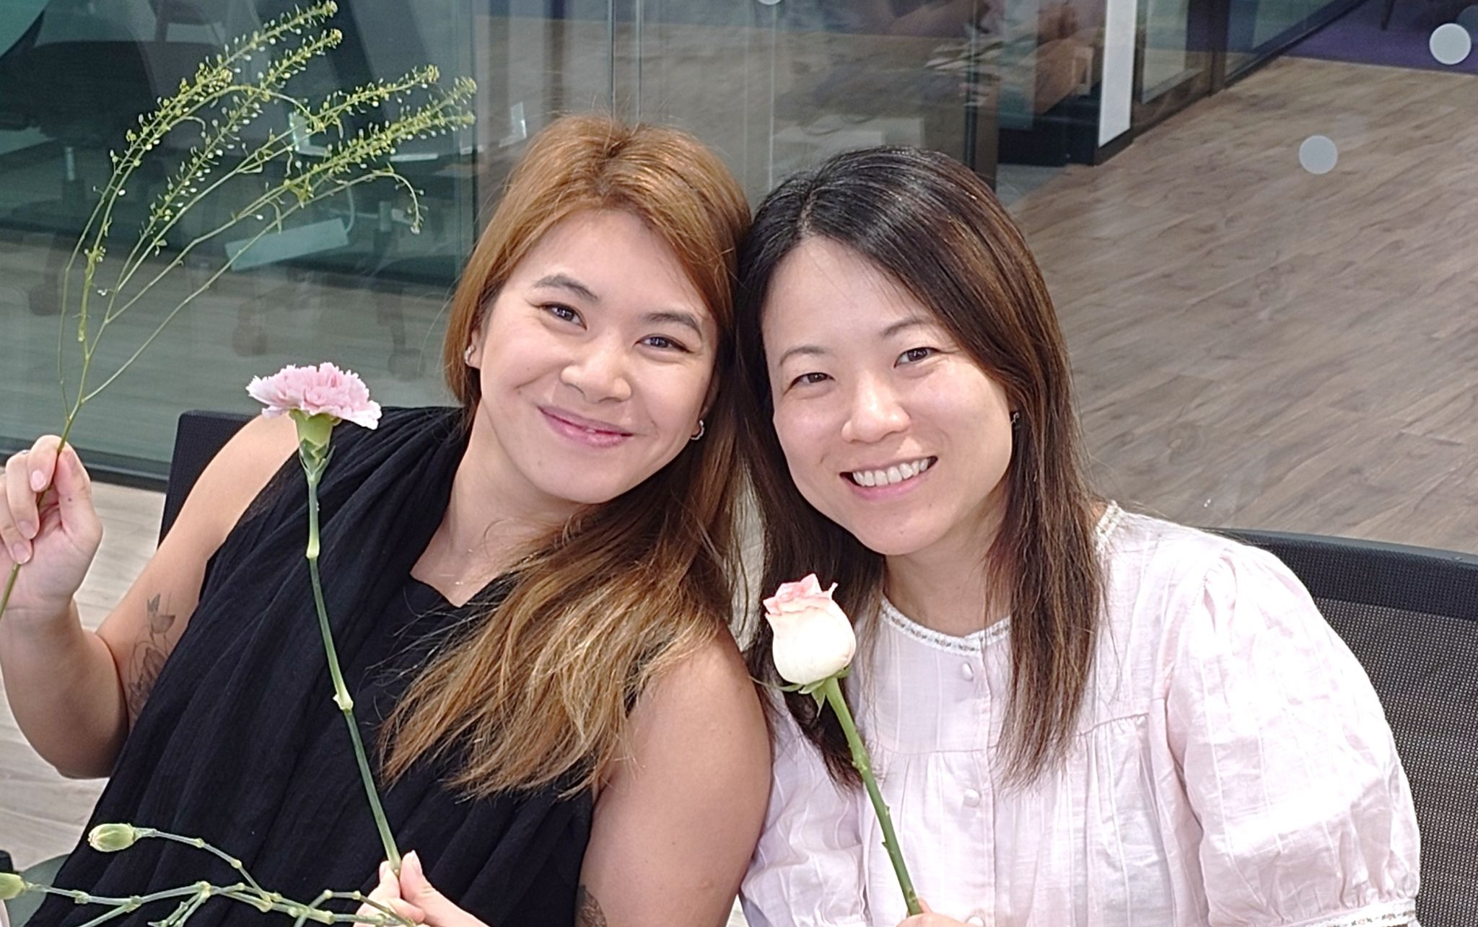
OUR OBJECTIVES
Equip Workforce: Focus on providing the workforce with essential, up-to-date skills in areas like digital marketing, event technology, and customer engagement strategies.
Sustain Motivation: Develop and implement strategies to keep employees motivated and satisfied, recognizing that happy employees lead to happy customers.
Supportive Culture: Commit to creating a supportive work culture by recognizing and rewarding effort, fostering professional growth, and building a community where everyone feels valued.

Slide 5
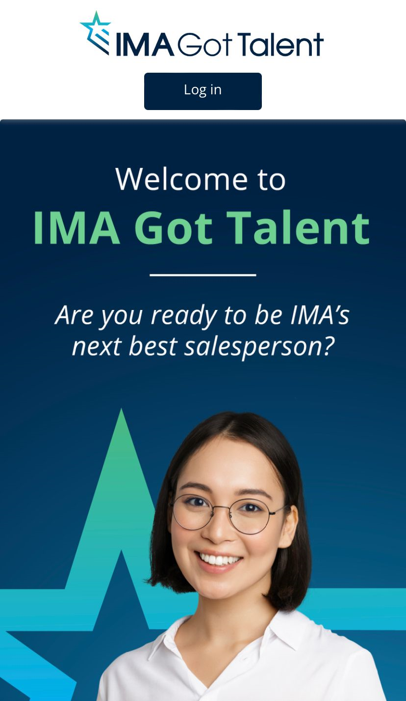
INTRODUCING "IMA GOT TALENT"
A gamified e-learning journey with prize and award to motivate the learning
Powerful AI based algorithm to customize your learning needs and personalize your learning experience
Proven high ROI with knowledge and skills retention even after 1 year
Informa Market Asia adopt this new approach to unleash our talents’ potential

Slide 6
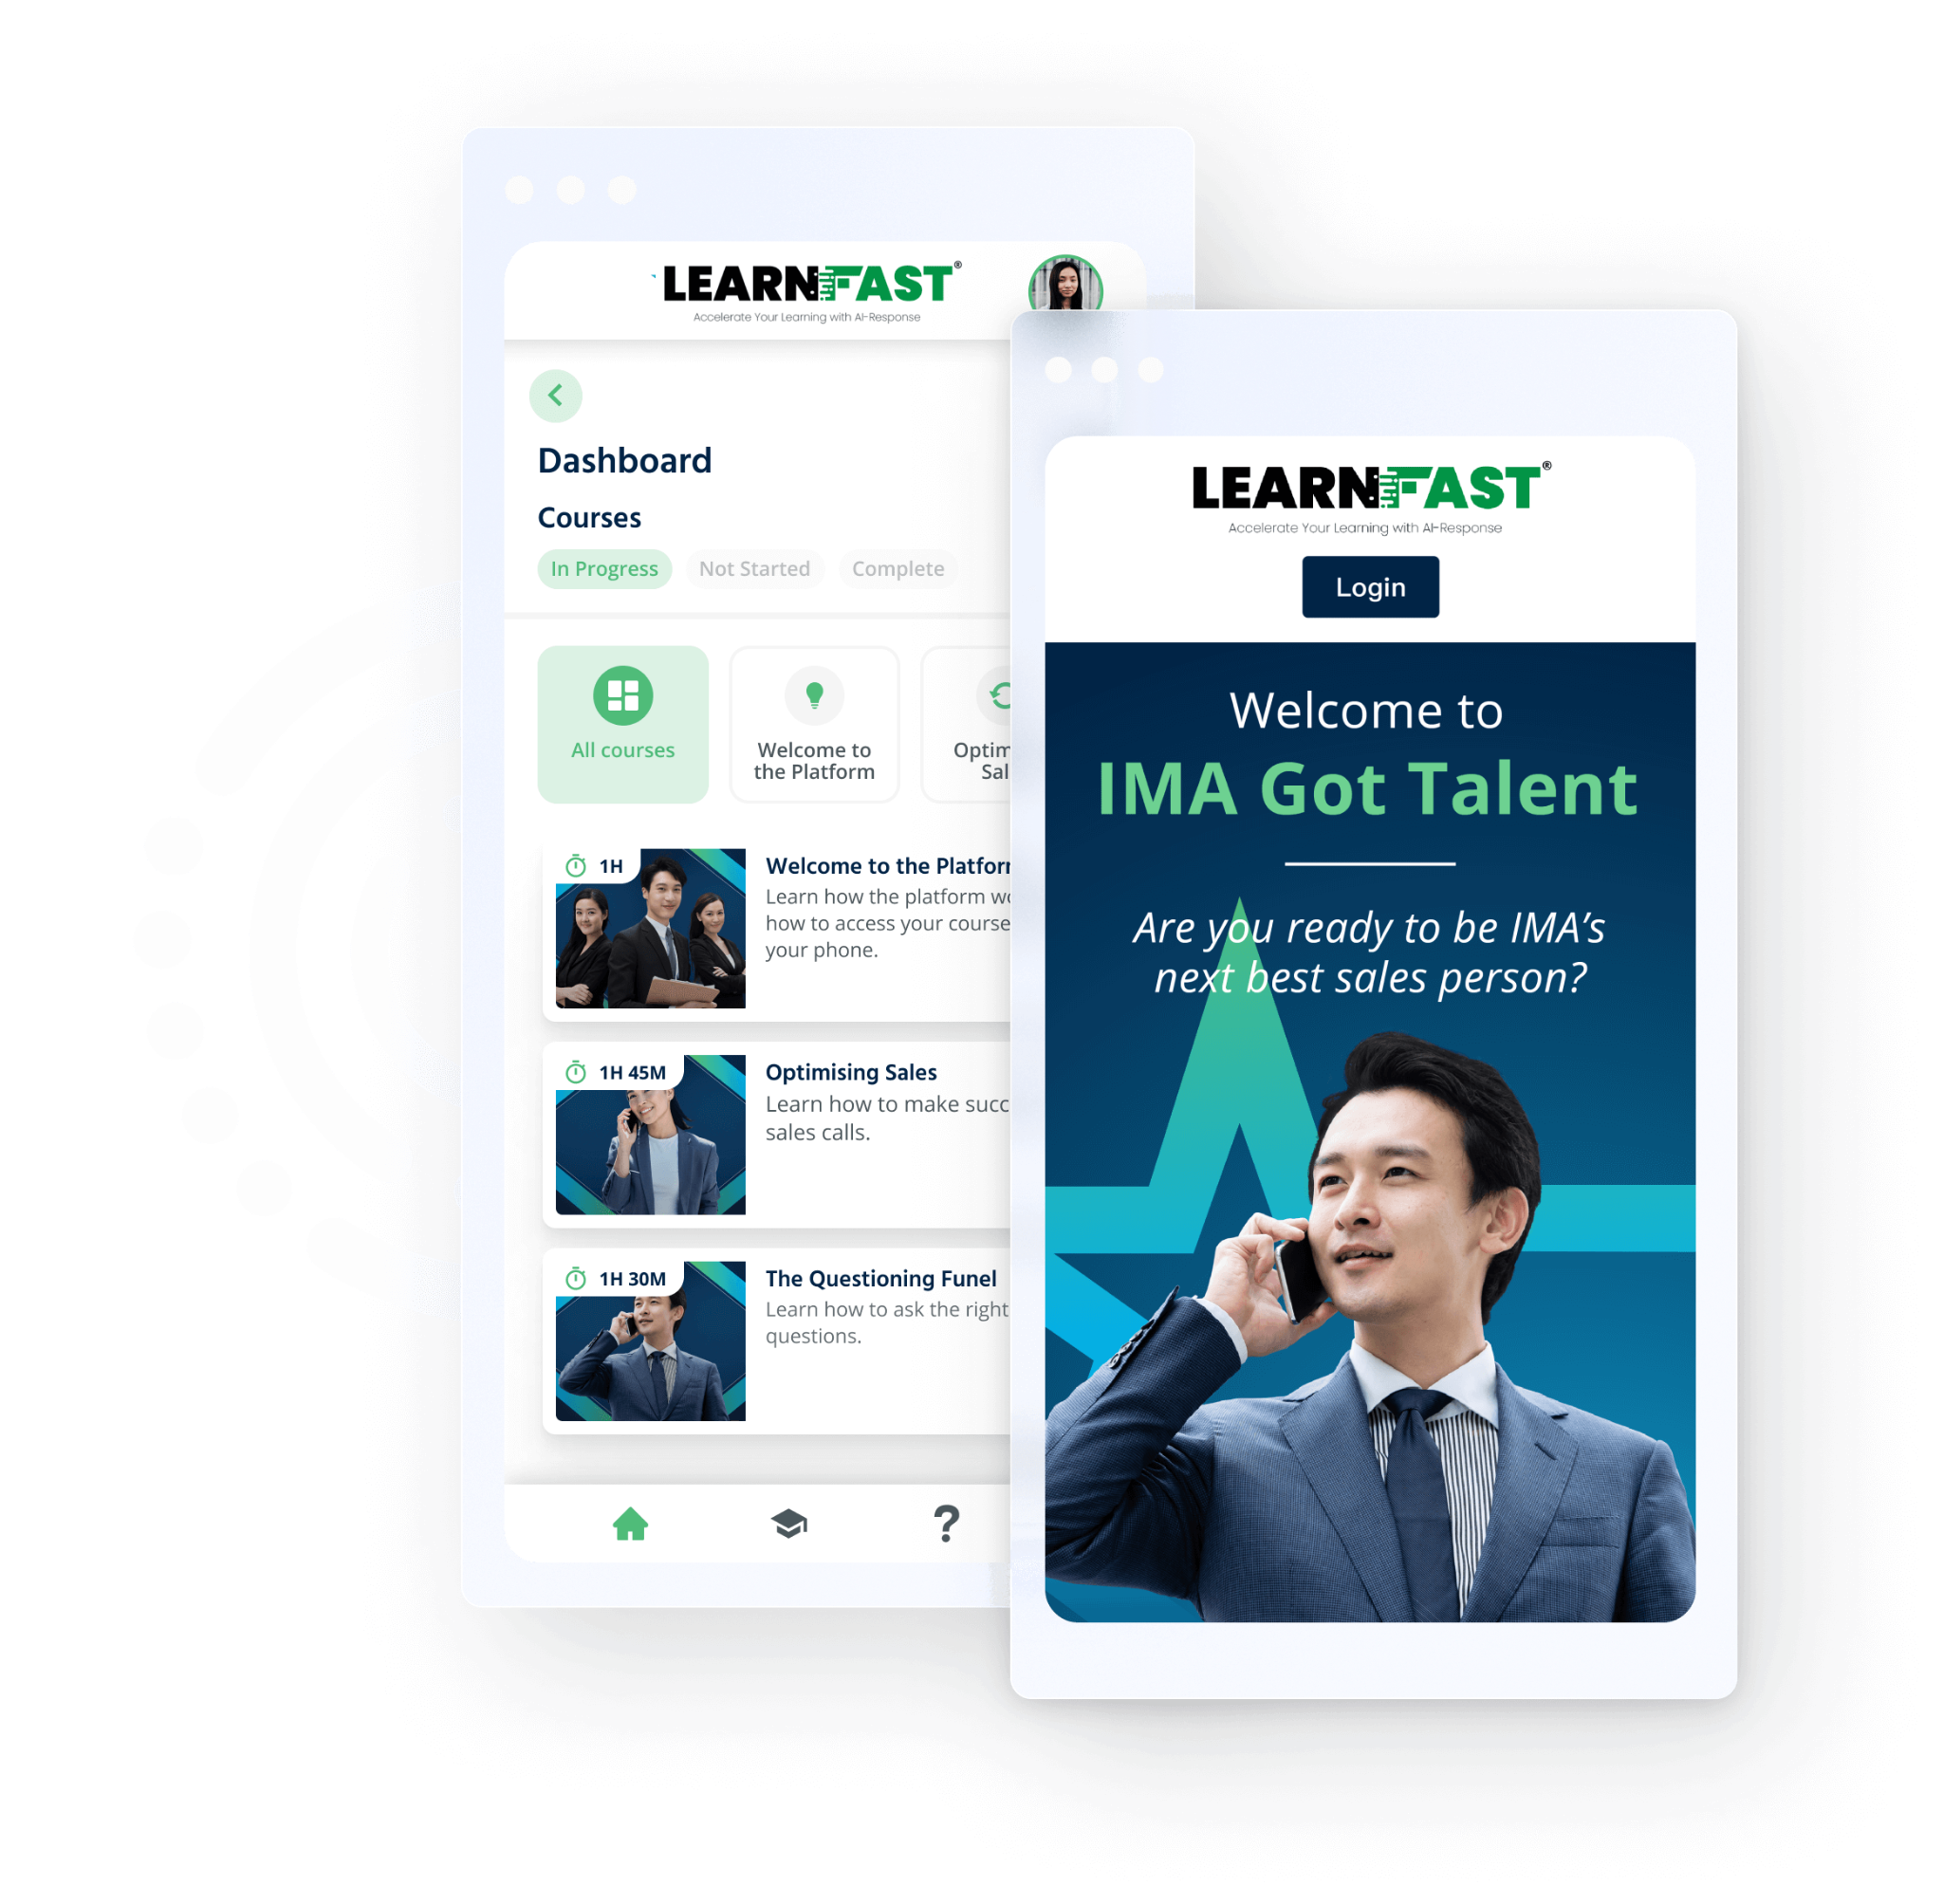
WHAT’S INSIDE THE PROGRAM
How it works?
This campaign aims to improve colleagues’ skills as a salesperson to help them earn more while helping Informa create more revenue.
All participants aim to complete the courses at the highest knowledge level and earn the most points.
Prize of top five learners at the end of every week and at the end of the six-week period.

Slide 7
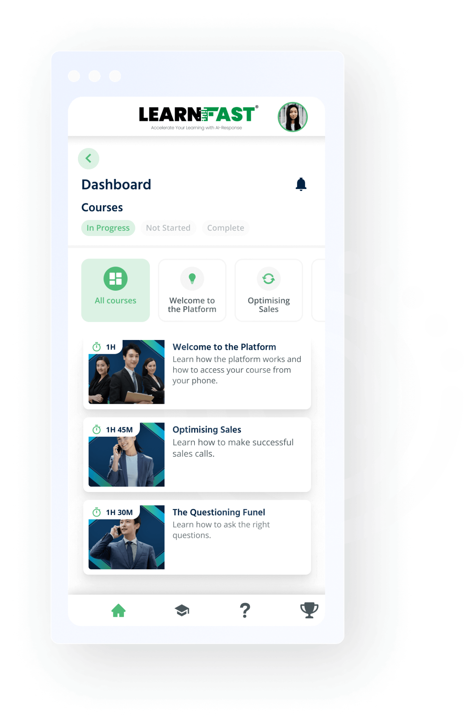
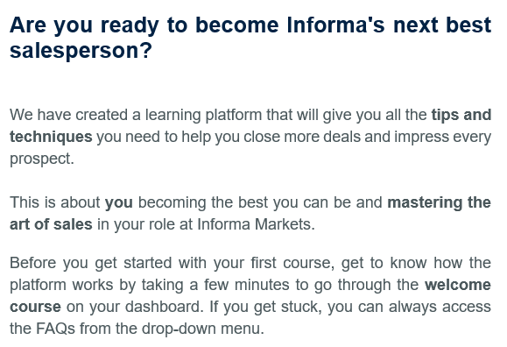
COURSE AND MODULES
Sales Optimization
Optimizing the Sales Process: Learn how to make a successful sales call.
The Questioning Funnel: Learn how to ask your prospects the right questions.
The Psychology of selling: Learn how to understand your prospects’ buying decisions.
The Art of Cold Calling: Learn how to make a successful cold call.

Slide 8
FINAL WINNERS
Name | Title | Location | Overall Points | Overall knowledge level
Puntara Janthanon | Sales Operation Executive | Thailand | 26,970,400 | 6
Claralee Fung | Assistant Manager, Digital & CRM | Hong Kong | 22,251,900 | 6
Vaishali Paul | Manager - Sales | India | 4,919,950 | 6
Click to view the video

Slide 9
RESULTS
143 Participants
4.63/5
Score of Enjoyment
100%
Positive feedback on learning habit change
6
Participants achieved Overall Knowledge Level 6
3668
Questions answered
2895 Correct answers

Slide 10
COMPARISON WITH TYPICAL E-LEARNING
The platform provide greater value than hiring six professional trainers to conduct two-hour training sessions each.
Increase participation among colleagues as it provided flexible and self-paced learning. Improved satisfaction and engagement among colleagues through interactive MC questions and the option to re-watch content anytime and anywhere.
Our company has invested heavily in Learning and Development, but the Return on Investment (ROI) and effectiveness of our training programs have been difficult to measure. Improved retention of knowledge among colleagues and colleagues can revisit training recordings. All these can be traced.
The high-quality videos, leaderboards & Points system enhancing the learning experience for our colleagues. Received positive feedback from colleagues and management on the effectiveness and value of the training provided by the platform.
Increased employee retention by providing professional development opportunities through the platform.
Contributed to a culture of continuous improvement by providing ongoing training and development opportunities for employees.

Slide 11
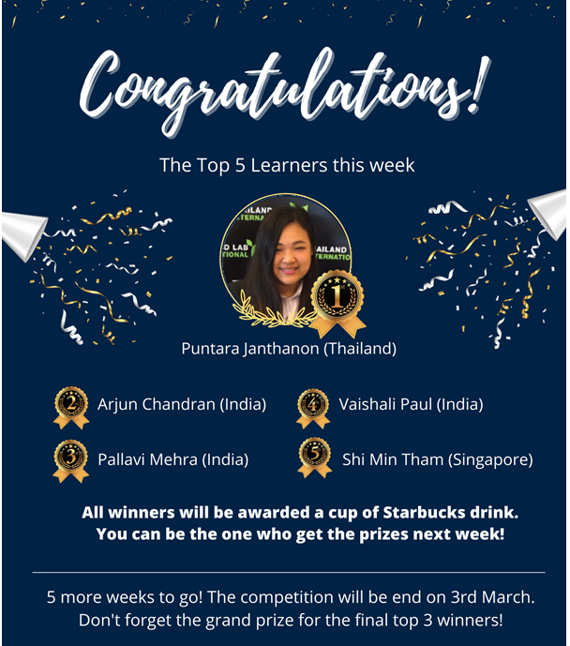
FUTURE PLANS
Collaborate with Informa Markets Clients
Rebranded the platform as "LearnFast“, and promote it to Informa Markets’ exhibitors
Introduced a new module "Exhibition Excellence" to help exhibitors prepare for tradeshows and enhance their performance
Enhance preparation for tradeshows, providing highly beneficial resources for exhibitors.
Partnering with India CPHI team to promote the platform to CPHI India exhibitors in November 2023
Planning to extend promotion to other tradeshows to make LearnFast a valuable resource for exhibitors worldwide

Slide 12
FUTURE PLANS
Collaborate with External Organization
LearnFast platform to be promoted to External Organizations
- The Global Association of the Exhibition Industry (UFI)
- Hong Kong Institute of Human Resource Management (HKIHRM)
Exhibition Excellence module will be developed
- Equip UFI members with tools to excel in their field
- From Pre-show, to Post-show evaluation
Bite-sized videos can offer on-the-go learning for HR professionals in HKIHRM.
- Promote a culture of Learning and Development
As one of the leading exhibition organizers, we are extending this culture of learning beyond our company, contributing significantly to the industry.

Slide 13
THANK YOU

Slide 14
Q&A

